Slide 1
Quality wine
DS-610-Big-Data-Analytics
Abhinav Singh

Slide 2
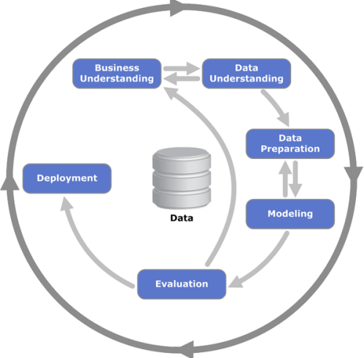
CRISP – DM
I used the CRISP (Cross-Industry Standard Process for Data Mining) methodology to give the directions of this project. This process, consists in a iterative and adaptive life cycle consisting of 6 phases, as shown on the side picture.

Slide 3
Business Understanding
The dataset was taken from kaggle.com
This datasets is related to red variants of the Portuguese "Vinho Verde" wine. For more details, consult the reference [Cortez et al., 2009]. Due to privacy and logistic issues, only physicochemical (inputs) and sensory (the output) variables are available (e.g. there is no data about grape types, wine brand, wine selling price, etc.).

Slide 4
Data Understanding - Dataset
Red Wine Dataset
- 1599 observations
Variables:
Fixed Acidity | Chlorides | pH
Volatile Acidity | Free sulfur dioxide | Sulphates
Citric Acid | Total sulfur dioxide | Alcohol
Residual Sugar | Density | Quality

Slide 5
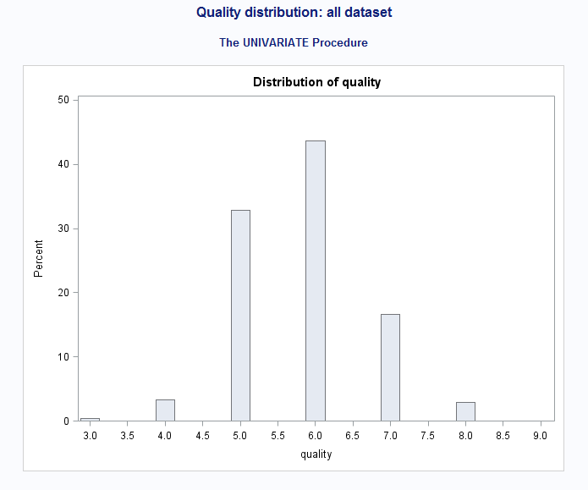
Data Preparation
No missing values
Create a model to predict quality
Created new column with following
If wine quality is higher than 6 = 1
If wine quality is less or equal 6 = 0
Only 20% of our data has HIGH quality after modification!

Slide 6
The Process
No missing values
Create a model to predict quality
Created new column with following
If wine quality is higher than 6 = 1
If wine quality is less or equal 6 = 0
Only 20% of our data has HIGH quality after modification!

Slide 7
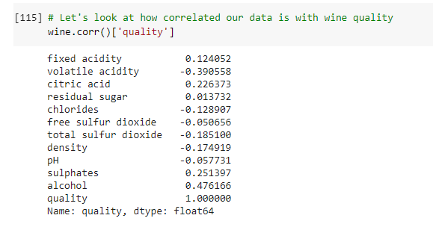
Exploratory Data Analysis
The correlation of all the features is given below:

Slide 8
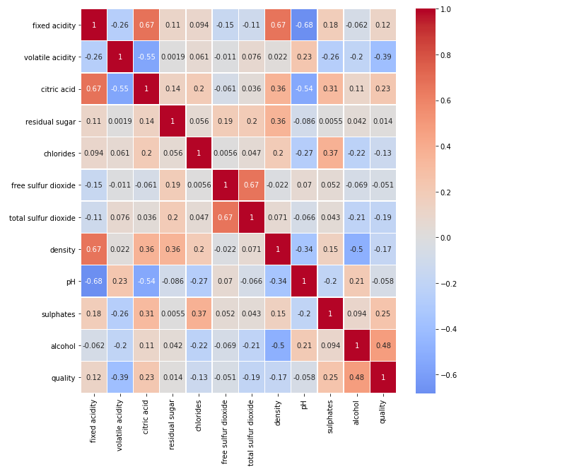
Exploratory Data Analysis
Let’s look at the heatmap correlation map

Slide 9
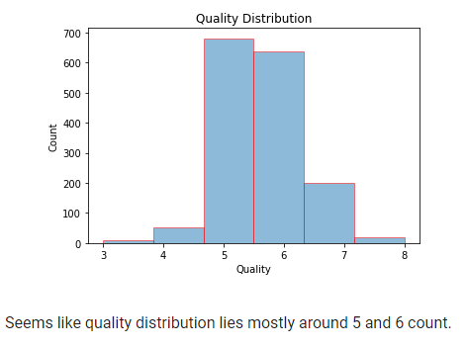
Exploratory Data Analysis
Let’s look at quality distribution

Slide 10
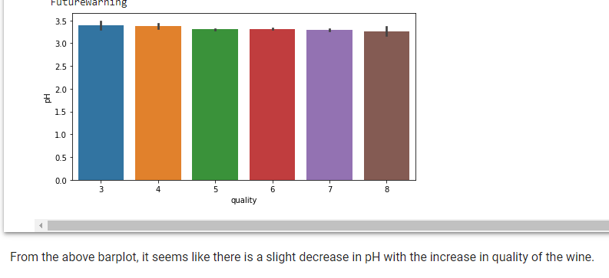
Exploratory Data Analysis
Let’s compare wine quality with different categories. Let’s start with wine quality and pH

Slide 11
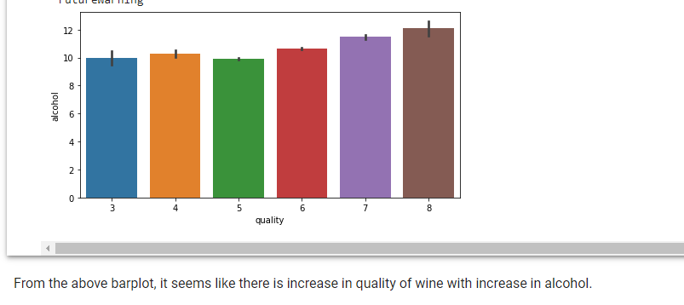
Exploratory Data Analysis
Now let’s compare wine quality and alcohol

Slide 12
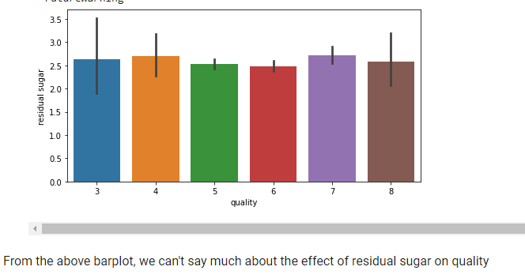
Exploratory Data Analysis
Now let’s compare wine quality and residual sugar

Slide 13
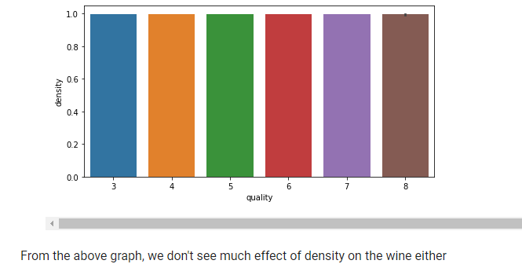
Exploratory Data Analysis
Now let’s compare wine quality and density

Slide 14
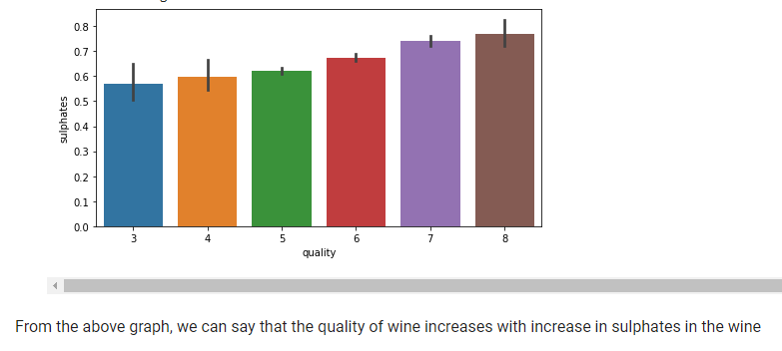
Exploratory Data Analysis
Now let’s compare wine quality and sulphates

Slide 15
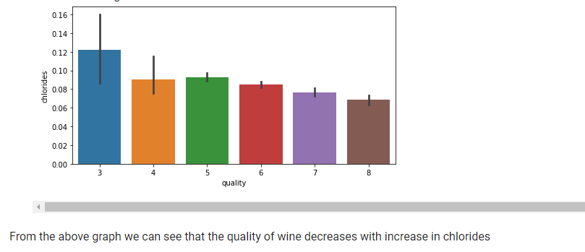
Exploratory Data Analysis
Now let’s compare wine quality and chlorides

Slide 16
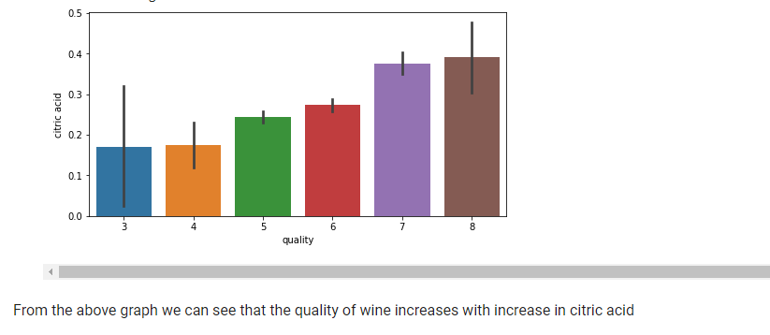
Exploratory Data Analysis
Now let’s compare wine quality and citric acid

Slide 17
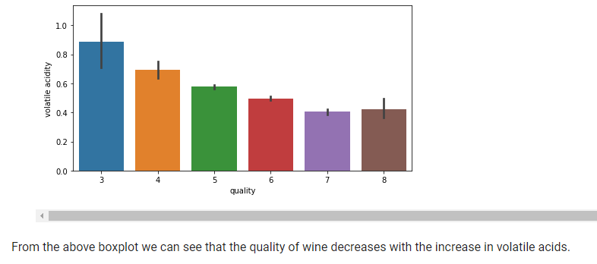
Exploratory Data Analysis
Now let’s compare wine quality and volatile acidity

Slide 18
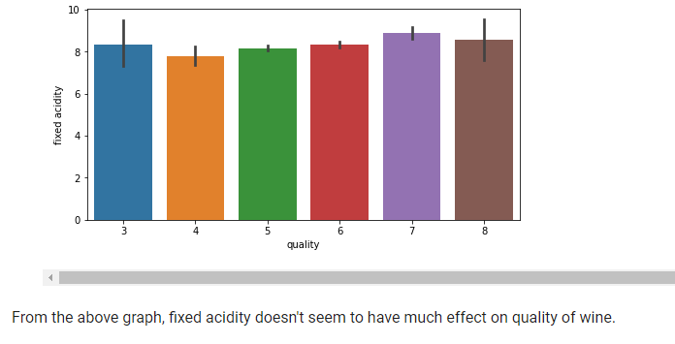
Exploratory Data Analysis
Now let’s compare wine quality and fixed acidity

Slide 19
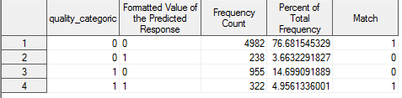
Evaluation
First we calculated the Individual Probability of good_quality to be 0 or 1
Then we compared the predicted with observed
Lastly we create a table to compare

Slide 20
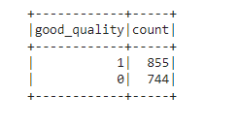
Evaluation
Let’s look at our newly created categorical variable

Slide 21
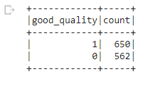
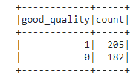
Data Modeling: Decision Tree Classification
Based on the EDA, we will now apply decision tree classification on the model.
We will transform data using vector assemblers.
We will split dataset into testing and training dataset with 75:25 ratio.
Here is our training and testing dataset

Slide 22
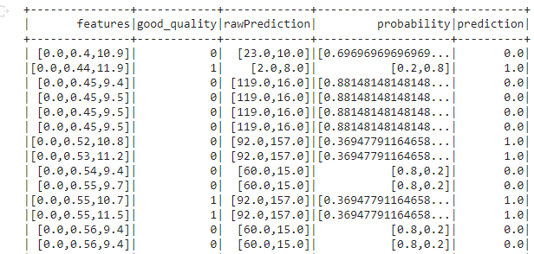
Data Modeling: Decision Tree Classification
Let’s look at the predictions

Slide 23
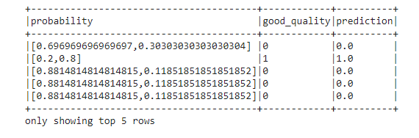
Data Modeling: Decision Tree Classification
Let’s look at prediction along with probability and good quality

Slide 24
Data Modeling: Decision Tree Classification
Let’s look at the accuracy of our model
So the accuracy of the model is 72%. Let’s see if our next model can do better.

Slide 25
Data Modeling: Random Forest Classification
Based on the EDA, we will now apply random forest classification on the model.
We will transform data using vector assemblers.
We will split dataset into testing and training dataset with 75:25 ratio.
Here is our training and testing dataset

Slide 26
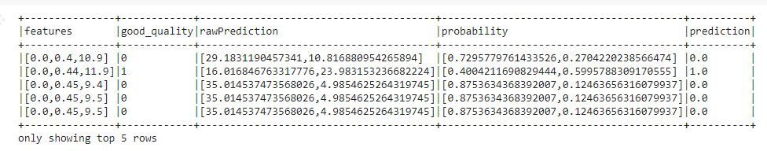
Data Modeling: Random Forest Classification
Let’s look at the predictions

Slide 27
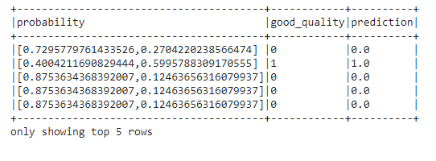
Data Modeling: Random Forest Classification
Let’s look at prediction along with probability and good quality

Slide 28
Data Modeling: Random Forest Tree Classification
Let’s look at the accuracy of our model
So the accuracy of the model is 78%.

Slide 29
Conclusion
The accuracy of Random Forest Classifier is much better than the accuracy of the Decision Tree Classifier and hence and hence gives better model.

Slide 30
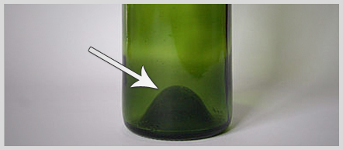
Decision:
What wine should I buy?
You can perform our Modeling and check for quality. Higher values suggest better wines and values close to 0 an low quality wine.
No calculator?
Use the punt of the bottle tip! =D

